Slide 1

Climate Change in Northumberland
Notes:
Introduce us both

Slide 2

Policy Context
Effective Climate Emergency response is a key priority for our residents.
Links to all three of the council’s key priorities:
Growth
Inequalities
Value for Money
Council has pledged to make the county carbon neutral by 2030 (excluding Methane and Nitrous Oxide emissions).
NCC propose an additional target for Methane and Nitrous Oxide emissions is also set for 2040. I.e. Full Net-Zero.
In line with the National Farming Union (NFU) as bulk of these emissions are from agriculture.

Slide 3


Slide 4
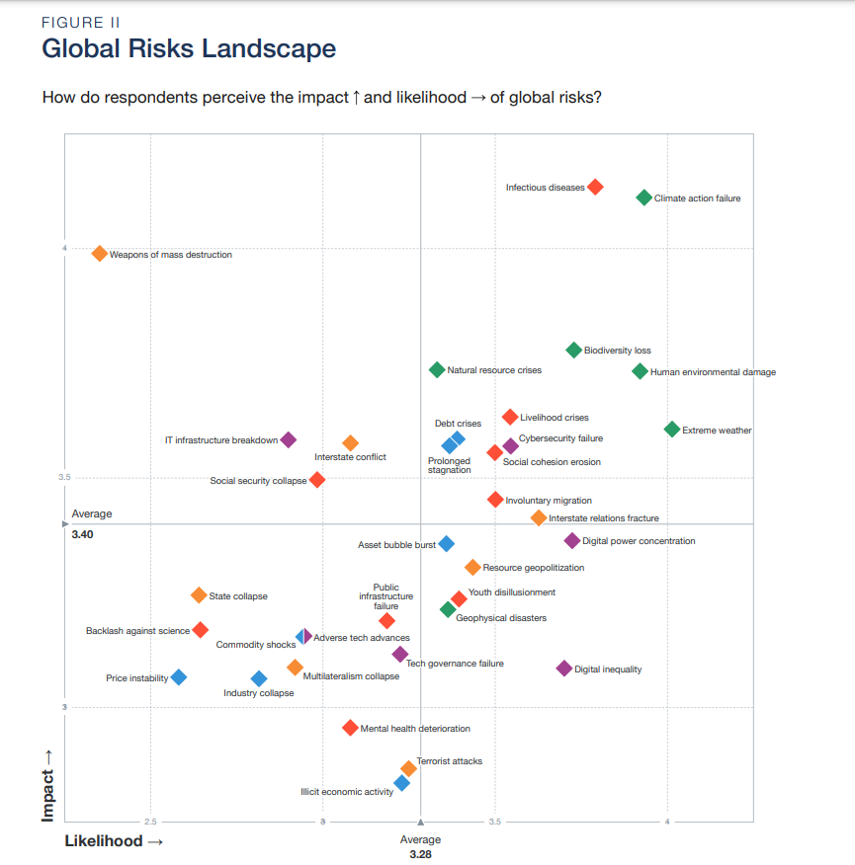

Slide 5
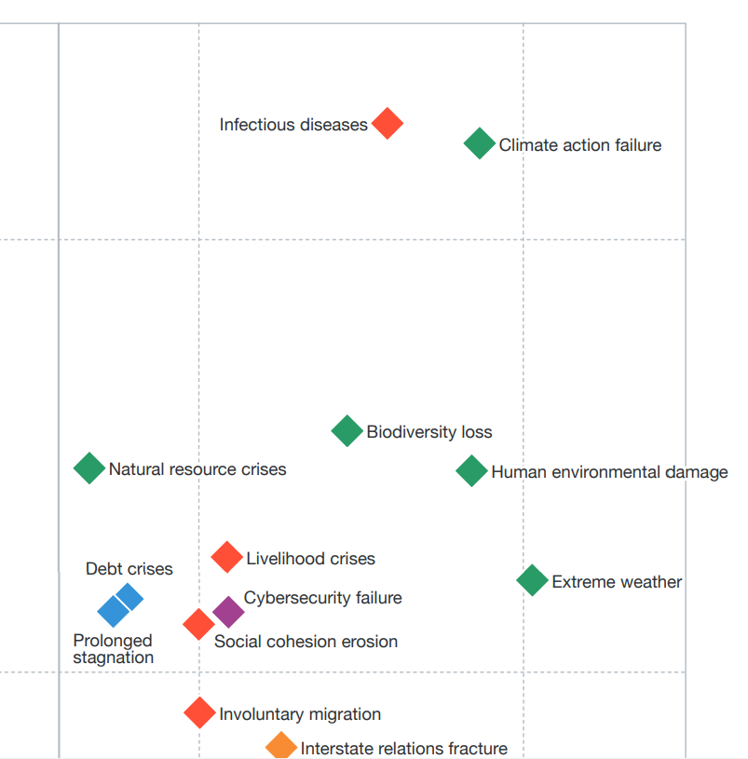

Slide 6
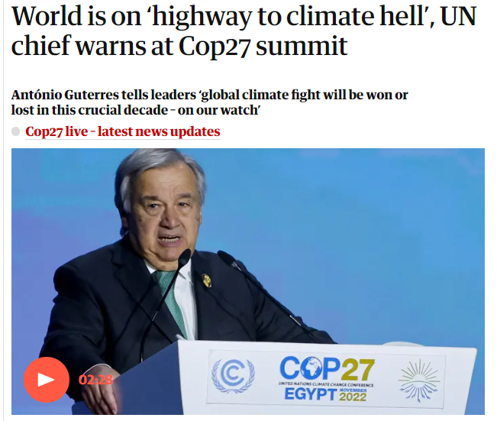

Slide 7








Predicted regional climate change impacts
2060-2079 | Summer rainfall | Winter rainfall | Summer temperature | Winter temperature
Low emission scenario | 11% drier | 6 % wetter | 1.5 C warmer | 1.1 C warmer
High emission scenario | 18% drier | 13% wetter | 3 C warmer | 2.4 C warmer

Slide 8
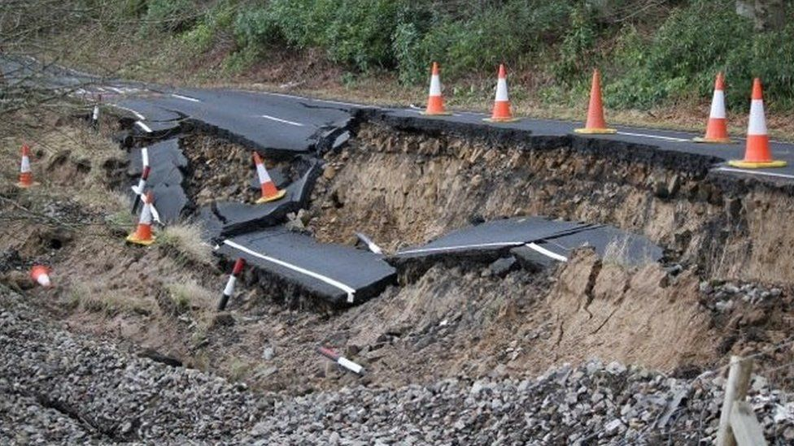
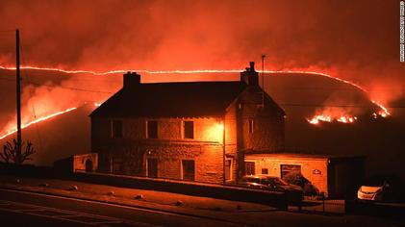
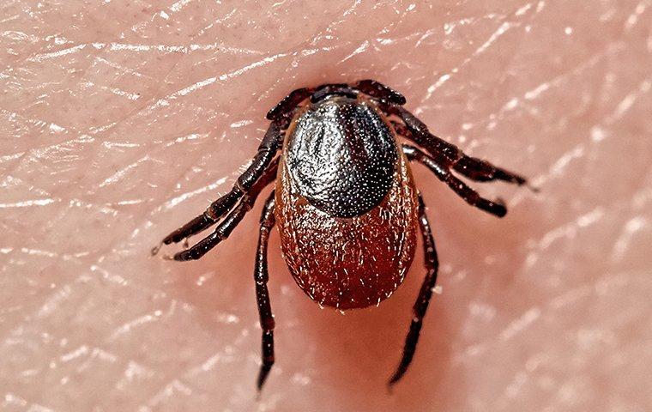
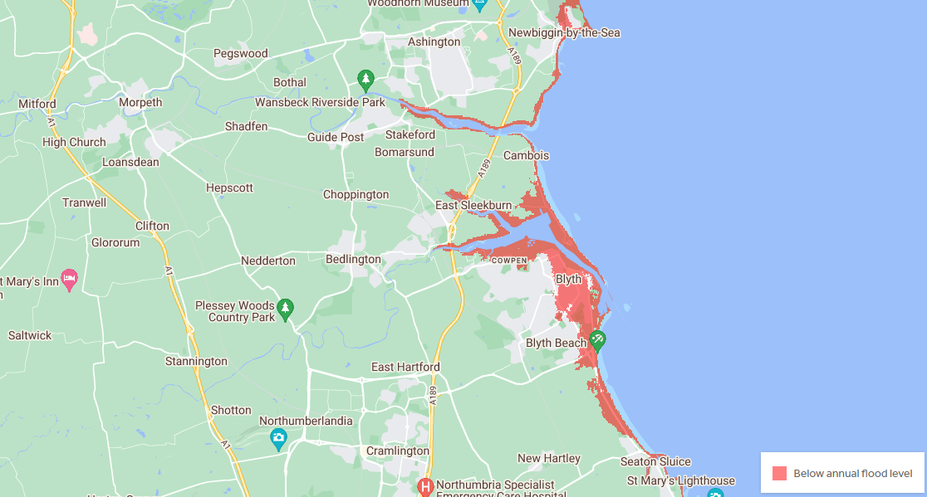
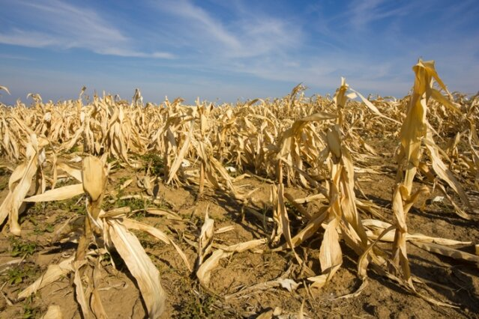
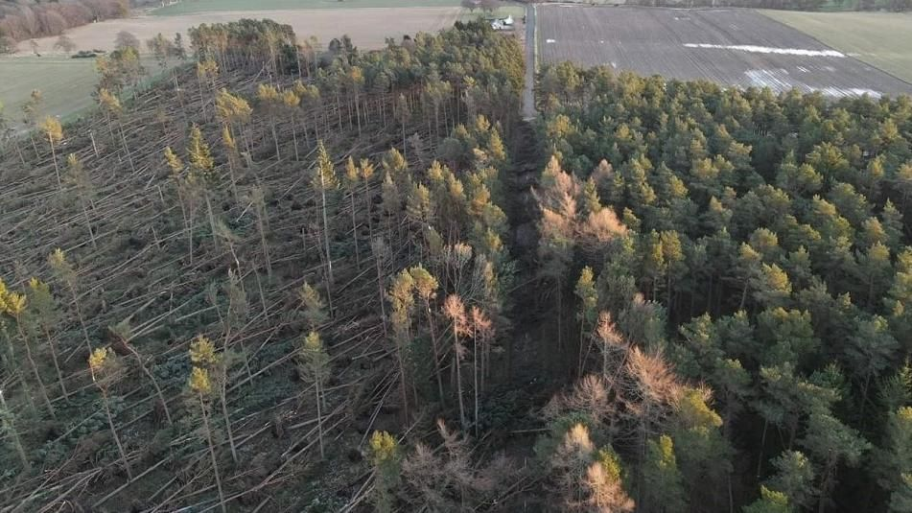
Impacts

Slide 9

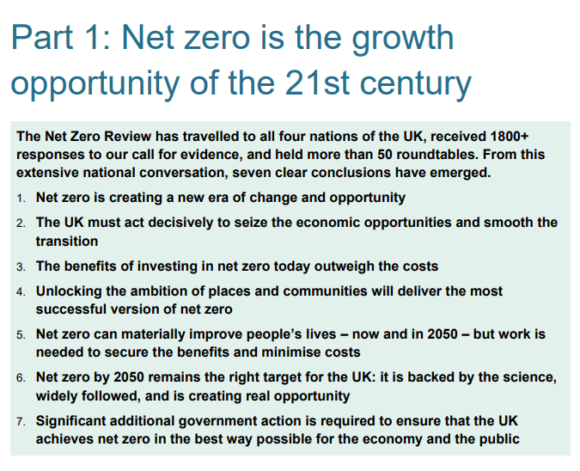

Slide 10
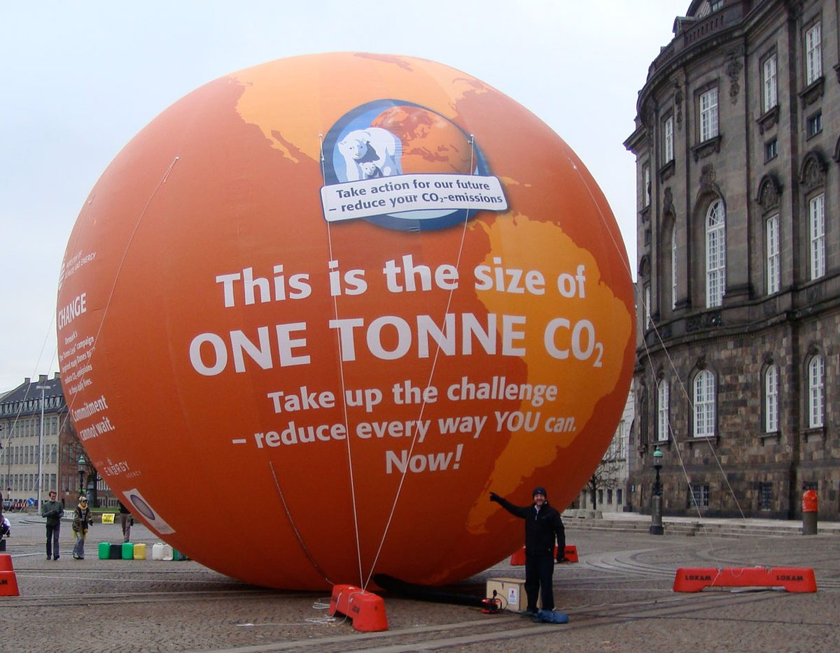
A bit of background – What is a tonne of CO2?
Driving 3,000 miles in a car
Heating an average Northumbrian home for 4 months
Extracting 15 barrels of oil
140 mature trees
32 square feet of Arctic sea ice
Notes:
NJ

Slide 11

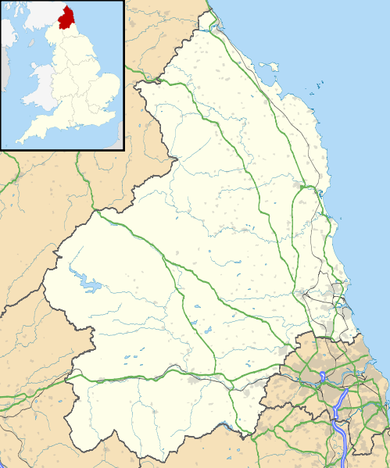










N₂O
CO₂
CH₄

Slide 12
1,374 kt CO₂e

Slide 13
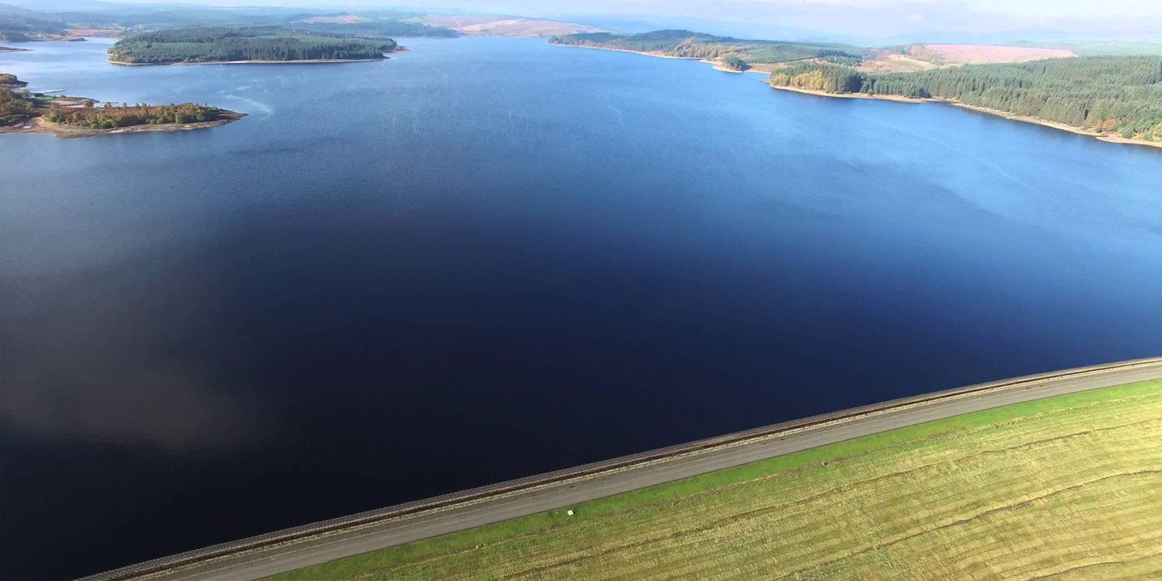
Nearly 4 times volume of Kielder Water
Notes:
NJ

Slide 14
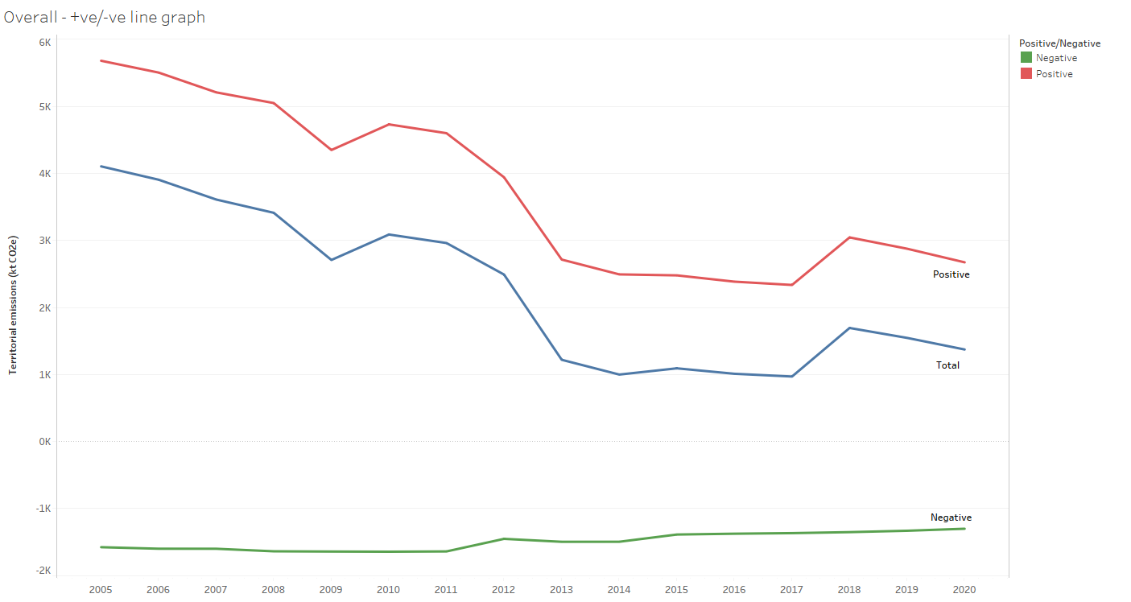

Slide 15
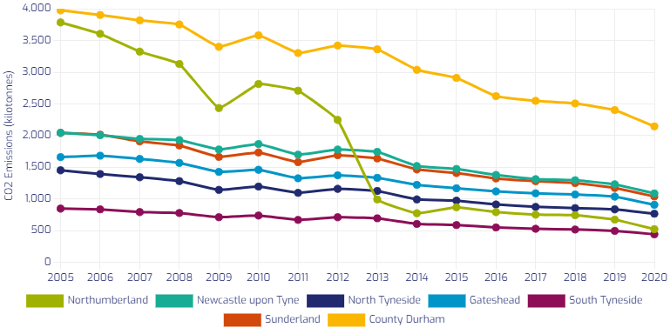

Slide 16
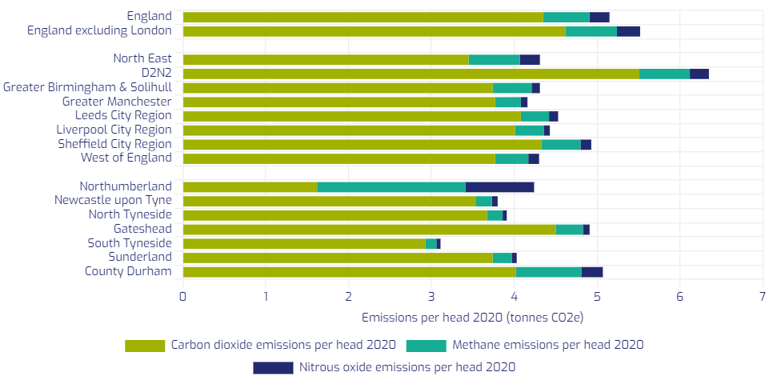

Slide 17


Slide 18
Action Plan 2021-23
Direct Contributors
Policy
Heating
Transport
Renewable Energy
Waste
Sequestration
Enablers
Partnerships

Slide 19
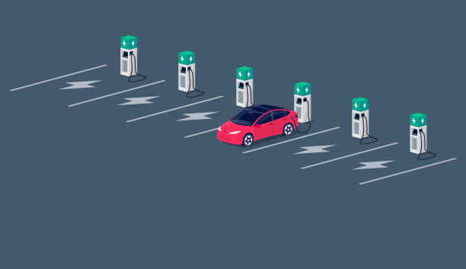
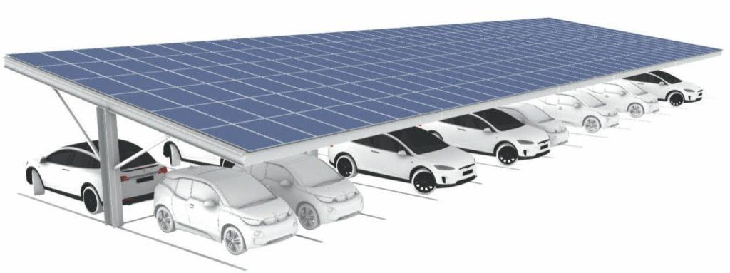





Slide 20
Reaching Carbon Neutrality
Notes:
NJ

Slide 21

Reaching Carbon Neutrality
Renewable heat covering 70% of homes and 50% businesses in our main towns
40% reduction in heat emissions from off-gas properties
30% all private cars EV
5000 hectares of new forestry
Peat restoration
Grid Decarbonisation
Cycling and Walking
Notes:
We could have planted 97.5 million trees 40 years ago but we didn’t
NJ

Slide 22

Adaptation and Resilience
Flood defence
Wild fire prevention
Food security
Energy security
Resilience in the built environment
Biodiversity preservation
Infectious disease prevention

Slide 23



Reducing Inequalities
In house schemes removing middle men and profiteering
Sustainable procurement
Reduced energy costs for buildings and vehicles
Affordable solutions
Value for Money
Insulating and retrofitting homes
Reducing fuel poverty
Developing skills for new technologies
Creating and maintaining green spaces
Sustainable, affordable transport
Economic Growth
Jobs in new, low carbon sectors
Attracting investment
Sustainable tourism
New infrastructure

Slide 24
Your input!
New climate action plan due at end of 2023
How do you feel about climate change in Northumberland?
What are the local opportunities?
What are the challenges you perceive?
Who is most vulnerable to the impacts associated with a changing climate?
How can we scale up?
How do we create traction and buy-in with local communities?
Where is climate change in your community’s priorities?
What ideas do you have?

Slide 25
climate@northumberland.gov.uk
Notes:
Introduce us both

